Slide 1


Slide 2
Welcome to
JQ Staffing Services
Policies & Procedures Safety Practices

Slide 3
WORKING FOR JQ STAFFING SERVICES
JQ Staffing Services is not an employment agency,
there is no fee to you for our services.
We have placed thousands of job seekers in positions.
We specialized in all aspects of Warehouse Production; including Administration, Clerical, Shipping & Receiving, Forklift Operating. JQ Staffing Services also specializes in Event Staffing and Hotel & Hospitality Staffing. We have placed thousands of job seekers in positions.
TEMPORARY TEMP TO HIRE DIRECT HIRE

Slide 4
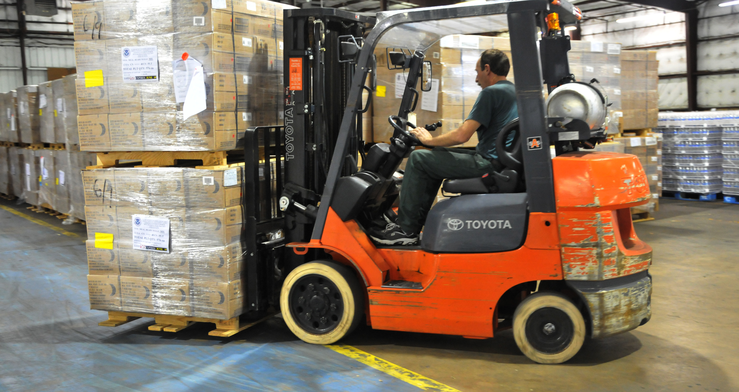



Slide 5

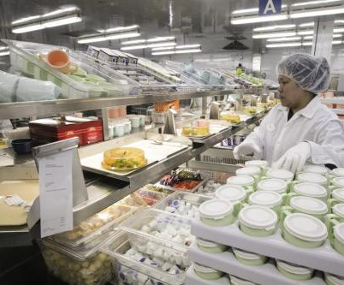

Slide 6


Slide 7
Safety is our goal!
Our safety theme…SAFETY, QUALITY, SERVICE describes the essence of what we are all about. To provide the best total solution to our clients we MUST seek the highest levels of productivity. Productivity isn’t working fast! Productivity is getting the job done correctly, the first time, at a cost that provides the best value to the customer.
Accidents are simply bad business!

Slide 8
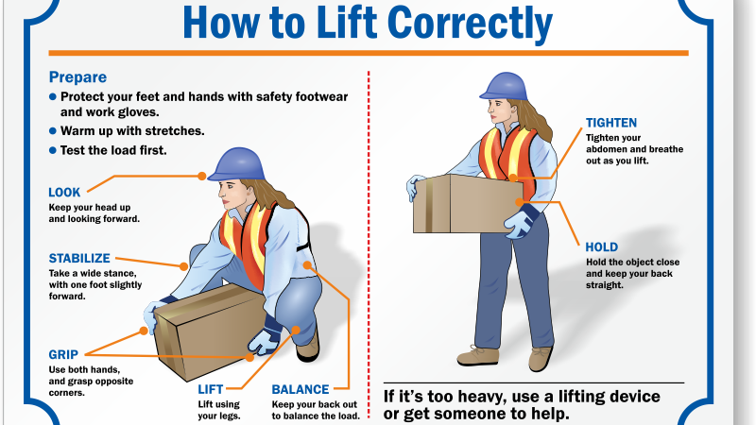

Slide 9
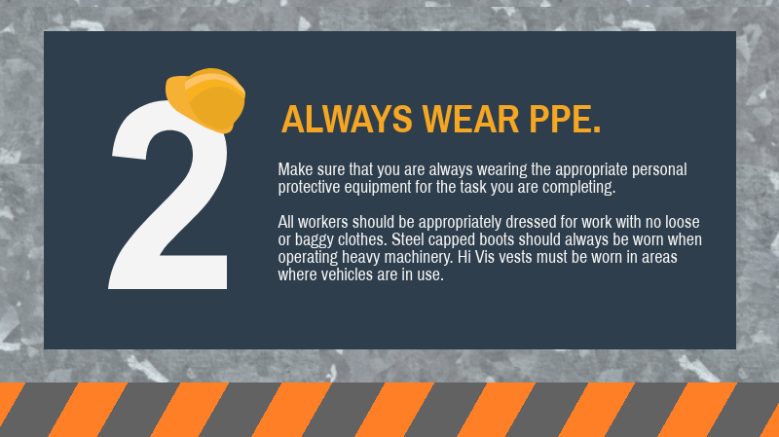

Personal Protective Equipment

Slide 13
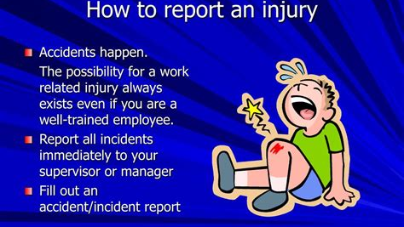

Slide 14

Drug Free Workplace
Use of alcohol and drugs on the job is strictly prohibited and will be grounds for dismissal. Pre-employment drug testing is required for some positions.
We reserve the right to require drug testing for any reason including testing after an on the job accident.

Slide 15


Slide 16


Slide 17


WE’RE
ALWAYS HIRING!!

Slide 18


Slide 19


Slide 20


